Slide 1
Server-side Programming
JSON and Simple REST

Slide 2
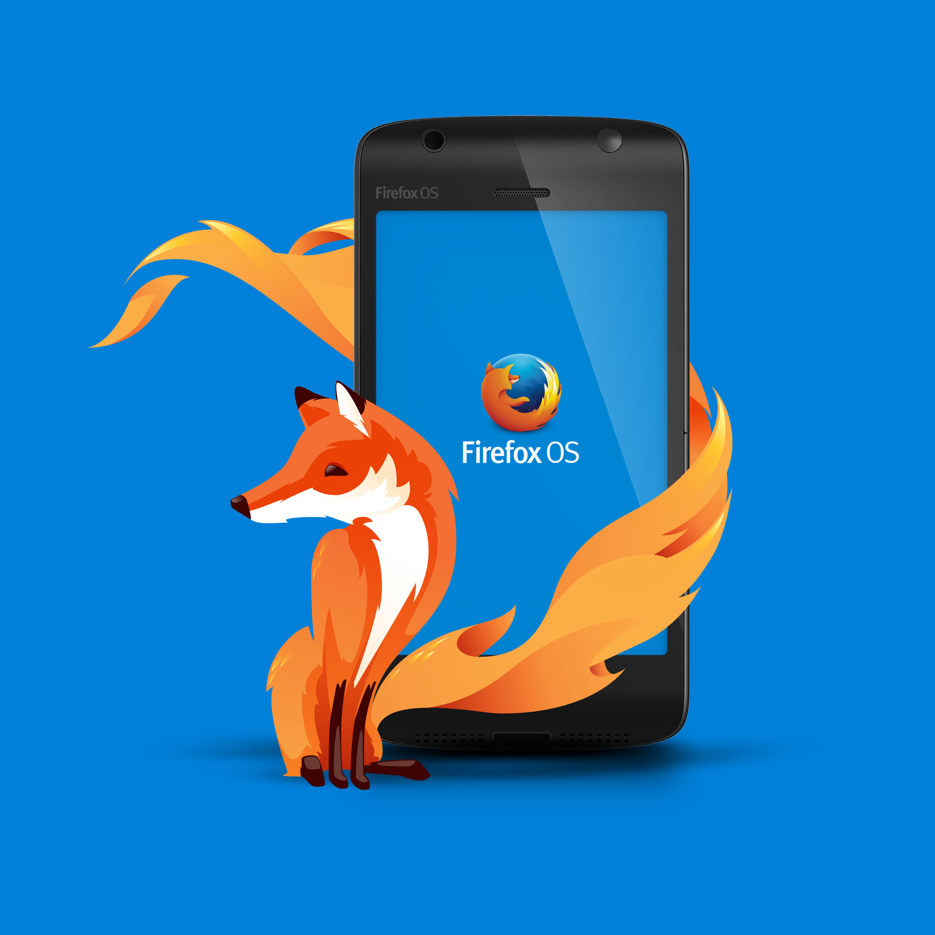
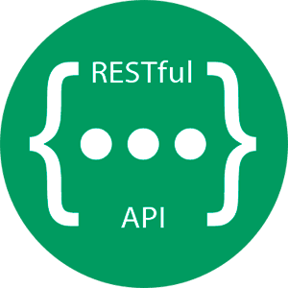

REST APIs help automate actions
Users through Browsers
Automation through APIs
Separate backend from frontend

Slide 3
APIs describe how to interact with a program or service
APIs are application program interfaces
They provide a way for different programs to interact
APIs come in all shapes and sizes
Software libraries all provide APIs
Any function you the user can all in a library is part of the API
REST, representational state transfer architecture is a style frequently used in server-based APIs
It describes a set of rules that must be followed
REST is flexible and clients can be written in almost any language

Slide 4
REST follows 5 basic principles
Uniform interface
Client-server decoupling
Statelessness
Cacheability
Layered system architecture

Slide 5
JSON is the standard way to communicate in REST APIs
Provides a lightweight format for sending data
Directly understood by Javascript
Other formats have been supported
E.g., XML as SOAP
{
"members": [
{
"name": "Molecule Man",
"age": 29,
"secretIdentity": "Dan Jukes",
"powers": [
"Radiation resistance",
"Turning tiny",
"Radiation blast"
]
}
]
}

Slide 6
Flask can directly handle JSON
JSON data can be sent back and forth using HTTP
Sending data to and from the server requires setting the content type in HTTP
JSON must be correctly encoded in when sent from the server
Python objects need to be translated into JSON
jsonify handles the conversion to JSON
@bp.route('/api/name')
def rest_api():
my_dict = {"name" : "Alice", "age" : 20}
return jsonify(my_dict)
@bp.route('/api/name')
def rest_api():
person = Person("Alice", 20)
return jsonify(person.__dict__)

Slide 7
Returning posts using REST

Slide 8
Query parameters are part of a URL
Query parameters are placed at the end of the URL
They are proceeded by a question mark (?) in the URL
Standard way to encode and decode the URL
Flask performs the decoding
# /api/person/?name=Alice
@bp.route('/api/person')
def rest_api():
if request.args:
name = request.args.get("name")
person = get_db().get_person(name)
return jsonify(person.__dict__)

Slide 9
Retrieve a blog post using a query string
Add a new route to post_api.py for fetching a given post by title
Use a query parameter to fetch the post and return it as JSON

Slide 10
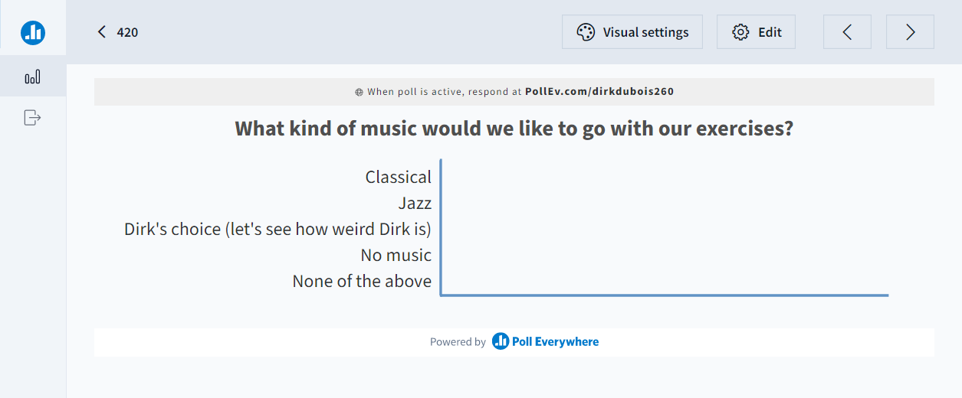
I want your feedback

Slide 11
REST APIs often use POST
Just like handling regular HTML forms, the server can handle posts to a REST end point
Note, the client must encode data as application/json
request will contain the json
@bp.route("/api/person", methods=['GET', 'POST'])
def address_book():
if request.method == 'POST':
result = request.json
person = Person.from_json(result)
get_db().add_person(person)
class Person:
def from_json(person_dict):
if not isinstance(person_dict, dict):
raise TypeError("Excepted dict")
return Person(person_dict['name'], person_dict['age’])

Slide 12
Javascript can be included as a static file
Typically, clients interact with the server through REST using Javascript
Built into the browser
Suports fetch to interact with the API
Flask can return Javascript files like any other static resource
<script defer type="text/javascript" src="{{ url_for('static', filename='script.js')}}"></script>

Slide 13
Fetch allows HTTP POST
Fetch in Javascript can handle any HTTP method including POST
By default fetch assumes GET of JSON
It can be configured to deliver data to the server similar to a form
The data sent over the POST should be JSON in REST APIs
fetch("/api/addressbook/",
{
headers: {
'Accept': 'application/json',
'Content-Type': 'application/json'
},
method: "POST",
body: JSON.stringify(address)
})
.then((response) => response.json())

Slide 14
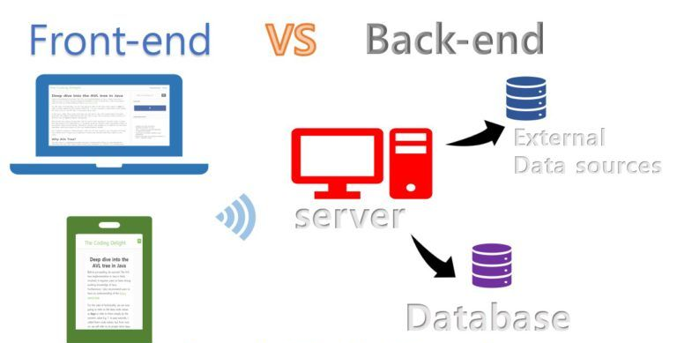
Typically, you use REST and client-side JS instead of templates
When using REST APIs the backend can be completely decoupled from the front-end
Instead of rendering templates on the server-side and returning HTML
Return static HTML pages that include Javascript
REST Server can even be separate from HTML server

Slide 15
Add a post using Javascript
Create a file called script.js that is delivered on the home page
Reuse the /api/posts route and add support for adding a new post using POST
Write Javascript code that calls the API

Slide 16
Additional resources
REST APIs : https://www.ibm.com/topics/rest-apis
Query parameters: https://developer.mozilla.org/en-US/docs/Learn/Common_questions/Web_mechanics/What_is_a_URL
jsonify: https://flask.palletsprojects.com/en/2.2.x/patterns/javascript/

